Slide 1
AI-Driven Facial Expression Recognition: EfficientNetB2-based Model for Emotion Classification
Future University in Egypt
AMIT Machine Learning Training
Presented by :
Rawan Asaad
Basant Medhat
Juliana Nader
Farah Ahmed
Merna Atef
Norhan Mohamed

Slide 2
Table of contents
01
02
03
04
05
06
Introduction
Model Architecture
Dataset and Preprocessing
Training Process
Enhancement
Evaluation and Results

Slide 3
Introduction
01

Slide 4
INTRODUCTION :
Facial Expression Recognition (FER) is a critical aspect of human-computer interaction, enabling machines to interpret and respond to human emotions. As technology advances, the ability to recognize and understand facial expressions has become increasingly important across various applications, including healthcare, security, entertainment, and customer service.
In this project, we explore the development of an AI-driven facial expression recognition system using the EfficientNetB2 architecture, a state-of-the-art deep learning model known for its efficiency and accuracy. By leveraging the power of EfficientNetB2, our model aims to classify facial expressions into seven distinct categories, offering a robust solution for emotion detection.

Slide 5
Dataset and Preprocessing
02

Slide 6
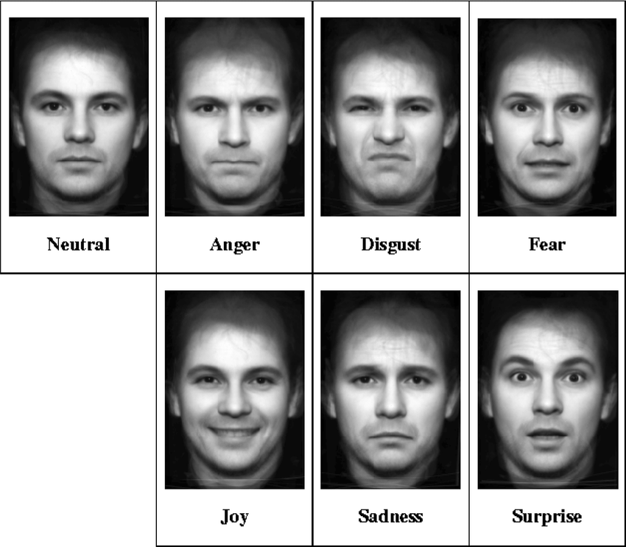
Dataset :
For our facial expression recognition project, we used a comprehensive dataset containing images categorized into seven distinct facial expression classes.
These categories represent a range of human emotions, providing the necessary diversity for training a robust model.

Slide 7
Preprocessing :
Path Setup : Using Python’s Pathlib, we defined the paths to the training and testing directories, allowing efficient file handling and data loading.
Label Extraction and Encoding: Labels were extracted from folder names. We used LabelEncoder from scikit-learn to convert these string labels into numeric form, enabling the model to process them effectively.
Data Splitting: The dataset was divided into training and validation sets using the train_test_split function from scikit-learn, with 75% of the data allocated for training and 25% for Testing. This ensures the model is tested on unseen data during training, promoting generalization and reducing overfitting.

Slide 8
Model Architecture
03

Slide 9
Machine learning algorithms
Algorithm | Type | Accuracy | Training Time | Applications
Linear Regression | Supervised | Moderate | Fast | Prediction, Regression
Decision Trees | Supervised | High | Moderate | Classification, Regression
Neural Networks | Supervised | High | Slow | Image Processing
K-Means | Unsupervised | Moderate | Fast | Data Clustering
SVM | Supervised | High | Moderate | Classification, Anomaly Detection

Slide 10
Model Architecture
We chose to use EfficientNetB2 for our project because it is the most effective neural network for facial expression recognition
Why EfficientNetB2 Is the most effective?
Selected for its balance between accuracy and computational efficiency.
Suitable for running on limited hardware while still achieving high performance in complex tasks like facial expression recognition.
Its ability to effectively learn and generalize from facial data makes it a top choice for projects focused on facial expression.

Slide 11
04
Training Process

Slide 12
Training Process :
Initial Phase: The model starts with supervised training using clean data to learn basic facial expression features.
Supervision Loss is applied during this phase to minimize the difference between predicted labels and actual labels.
Data Augmentation:
Augmentation Techniques:
Techniques like random flipping, rotation, and zooming are applied to the training data to enhance model generalization and robustness against overfitting.
Impact on Training:
Augmentation helps the model become more robust to variations in facial expressions and head poses.

Slide 13
Training Process :
Batch size determines the number of samples processed before updating model weights, balancing memory usage and training speed.
Epochs control the total training cycles, allowing the model to learn patterns effectively.
Learning rate scheduling adjusts the learning rate dynamically, ensuring stable convergence and preventing overshooting during training.
Together, these parameters optimize model performance and generalization.

Slide 14
Evaluation and Results
05

Slide 15
Evaluation and Results
62%
72%
53%
1.1528
Accuracy
Precision
Recall
Loss
indicates the proportion of correct predictions
assesses the ratio of true positives to the sum of true and false positives
evaluates the ratio of true positives to the sum of true positives and false negatives.
measures the difference between predicted and actual values

Slide 16
Enhancement
06

Slide 17
Various Approaches to Improve Training
Change
Try
Filter
Increase Number of phases and Decrease number of epochs per phase while training.
Try out a better version of EfficientNet
By filtering out all images which were not detected by face detection algorithm we can make our model more robust

Slide 18
Thanks!
Do you have any questions?

